Slide 1

Empirical Investigation
MSA-Level Labor Market Development
Notes:
Today I would like to present our investigation in aggregate-level employment polarization
Following our earlier analysis

Slide 2
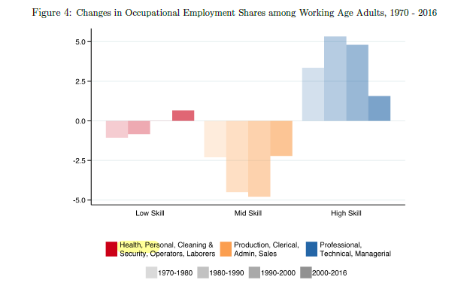
I. Previous Work: Autor (2019)
Autor, D., 2019. Work of the Past, Work of the Future. National Bureau of Economic Research.
Notes:
Fig 4 would imply that over 1980-2016 there was no labor market polarization, in contrast to Autor-Dorn’s work in 2013.
To understand the aggregate changes, we reproduce this Fig 4 using our data and consider (i) Autor’s classification (ii) PCS definition (iii) the classification used in Cerina et al. 2019

Slide 3
II. Data Source
Autor (2019): IPUMS-CPS to plot Figure 4 and IPUMS-USA to plot Figure 7 (we discussed before).
IPUMS-CPS is an integrated set of data from 57 years (1962-present) of the March Current Population Survey (CPS), whereas IPUMS-USA contains (1970, 1980, 1990, and 2000) census data and 2001-2020 ACS data.
I reproduced Figure 4 using our data (IPUMS-USA) since it only requires 1970, 1980, 1990, 2000, and 2016 data.
Notes:
So about the data source
- 诶噗木思 USA data

Slide 4
III. Reproduce Autor (2019) Figure 4:
Notes:
I used the Autor (2019) classification to reproduce Figure 4.
- There is still no polarization between 1980 and 2016 especially for low-skill jobs

Slide 5
III. Reproduce Autor (2019) Figure 4
Notes:
Then we considered the definition used in cerina eetal 2019, where they only treat services as low-skill jobs.
- There sure are positive changes for both low-skill n high-skill categories

Slide 6
III. Reproduce Autor (2019) Figure 4
Notes:
Further we considered the PCS French
- There sure are employment polarization for the past 4 decades

Slide 7
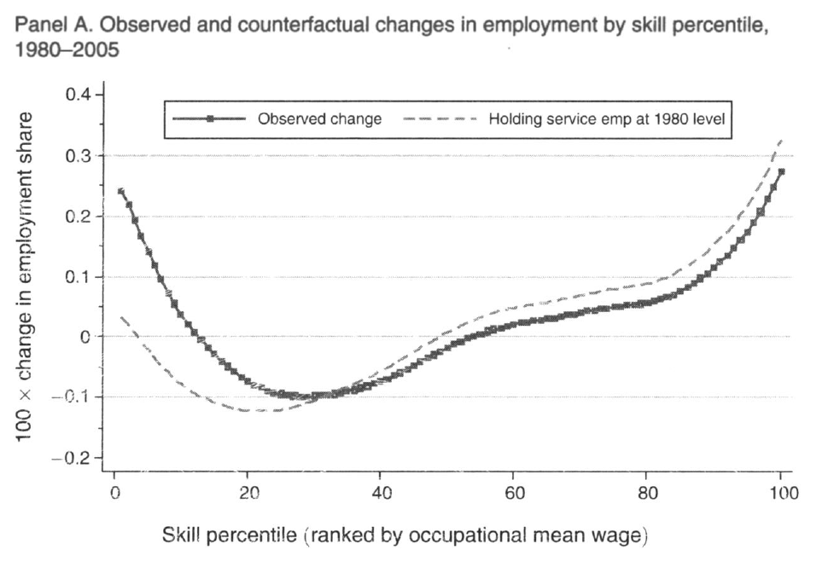
IV. Previous Work: Autor & Dorn (2013)
Autor, D. and Dorn, D., 2013. The growth of low-skill service jobs and the polarization of the US labor market. American Economic Review, 103(5), pp.1553-97.
Notes:
The previous analysis of Autor 2019 would suggest there is no increase in the share of low-paid jobs according to Autor’s classification. there would be no labor market polarization. This is at odds with earlier Autor’s influential writings, so we want to understand where the discrepancy is coming from.
e.g. Fig 2 & 3 from Autor and Dorn 2013.
Figure 2 highlights the contribution of service occupations to aggregate employment polarization.
This panel shows that reweighting the distribution of employment in 2005 to hold the share of service occupations constant 1980 level substantially reduces the upward twist of the lower tail of the employment distribution during this twenty-five years

Slide 8
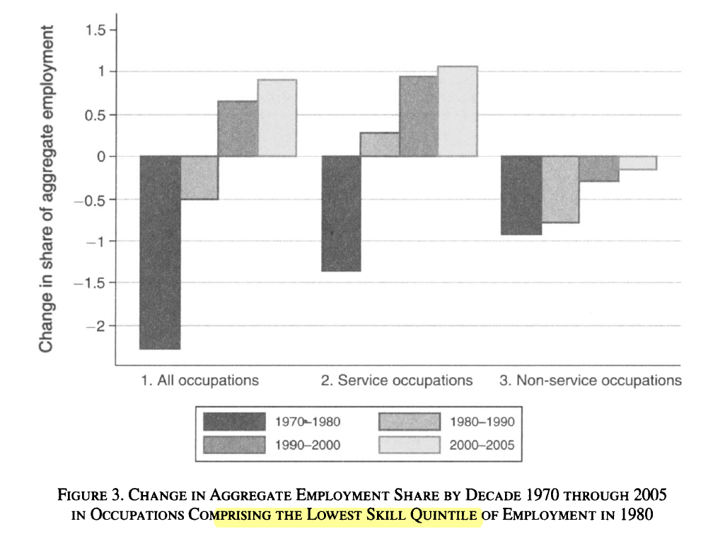
IV. Previous Work: Autor & Dorn (2013)
David, H. and Dorn, D., 2013. The growth of low-skill service jobs and the polarization of the US labor market. American Economic Review, 103(5), pp.1553-97.
Notes:
Autor and Dorn (2013) simplify the discussion to either high-skill or low-skill jobs based on their skill percentiles. My understanding is that they rank the 330 occupations (given by Autor-Dorn classification) using mean occupational wage in 1980. Then, the lowest skill quantile indicates the low-skill category.
On the contrary, Autor (2019) first assigned six smaller occupational categories to low-/mid-/high-skill groups directly, i.e. low skill: services, transport construction & laborers. without considering the mean wage of each occupation.

Slide 9
According to Autor & Dorn (2013), in 1980, 47 percent of employment in the lowest quintile was in service occupations and 92 percent of service occupation employment was in the lowest quintile.
In 2005, 55 percent of employment in the lowest quintile was in service occupations and 89 percent of service occupation employment was in the lowest quintile.

Slide 10
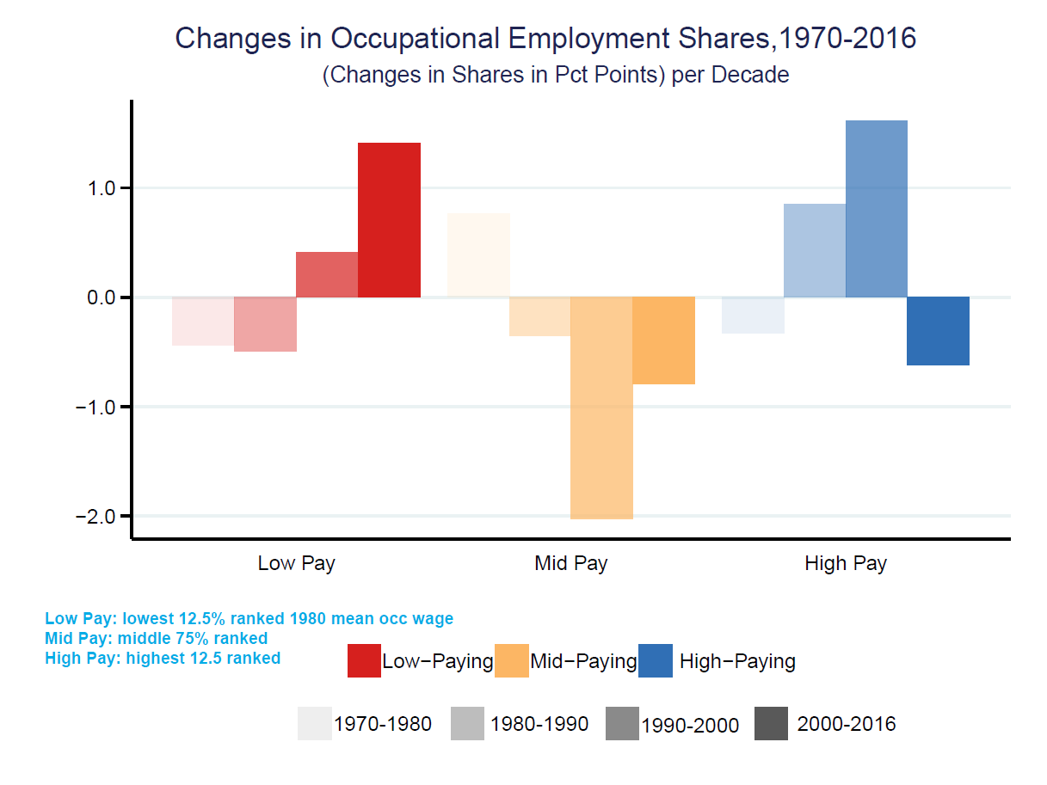
IV. Previous Work: Autor & Dorn (2013)
Notes:
Here we consider
Lowest 12.5% ranked in terms of average wages in 1980 as low-paid jobs
Highest 12.5% ranked as high-paid jobs
Middle-paid includes all in between

Slide 11
IV. Previous Work: Autor & Dorn (2013)
Notes:
This is when we separate mid-paid jobs into two subgroups – lower and higher mid paid
Then we have only negative changes for lower mid pay jobs and only positive changes fo higher mid pay jobs
Since there is a negative change between 2000 and 2016 for high-pay jobs, we are curious about the detailed composition of that high-pay category.

Slide 12
Negative Changes
occ1990dd=64, experience the most negative changes (2000-2016) -0.1199 (-11.99%)
A.3 Professional Specialty Occupations - Computer systems analysts and computer scientists
occ1990dd=13, experience the second most negative changes (2000-2016) -0.0121 (-1.21%)
A.1 Executive, Administrative, and Managerial Occupations - Managers and specialists in marketing, advert., PR
occ1990dd=255, experience the third most negative changes (2000-2016) -0.0107 (-1.07%)
B.2 Sales Occupations - Financial service sales occupations

Slide 13
2. Positive Changes
(1) occ1990dd=154, experience the most positive changes (2000-2016) 0.0288 (2.88%)
A.3 Professional Specialty Occupations - Subject instructors, college
(2) occ1990dd=26, experience the second highest positive changes (2000-2016) 0.0225 (2.25%)
A.2 Management Related Occupations - Management analysts
(3) occ1990dd=7, experience the third highest positive changes (2000-2016) 0.0223 (2.23%)
A.1 Executive, Administrative, and Managerial Occupations - Financial managers

Slide 14
IV. Previous Work: Autor & Dorn (2013)

Slide 15
IV. Previous Work: Autor & Dorn (2013)

Slide 16
IV. Previous Work: Autor & Dorn (2013)
Notes:
Here I used mean occupational wage in 1980 to rank and group the jobs
And I plot the Metropolitan – level employment share patterns according

Slide 17
IV. Previous Work: Autor & Dorn (2013)
Notes:
I also used mean occupational wage in 1990 to rank and group the jobs

Slide 18
Thank You!

